Slide 1
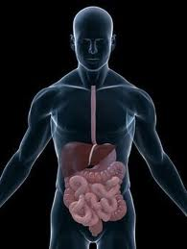
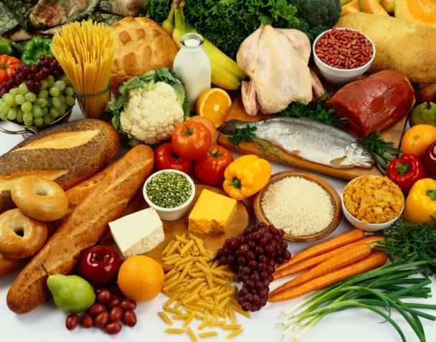
Macromolecules
& Digestion 7.2E & 7.6C

Slide 2
Proteins
Proteins are found everywhere – inside of
cells, in membranes, and outside of cells.
Proteins play many roles for organisms.
Proteins are made from amino acids.
What is an amino acid? Click here to find
out.
Broken down in the stomach into
amino acids.

Slide 3
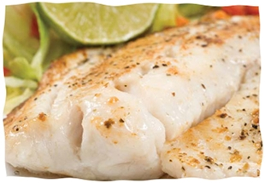
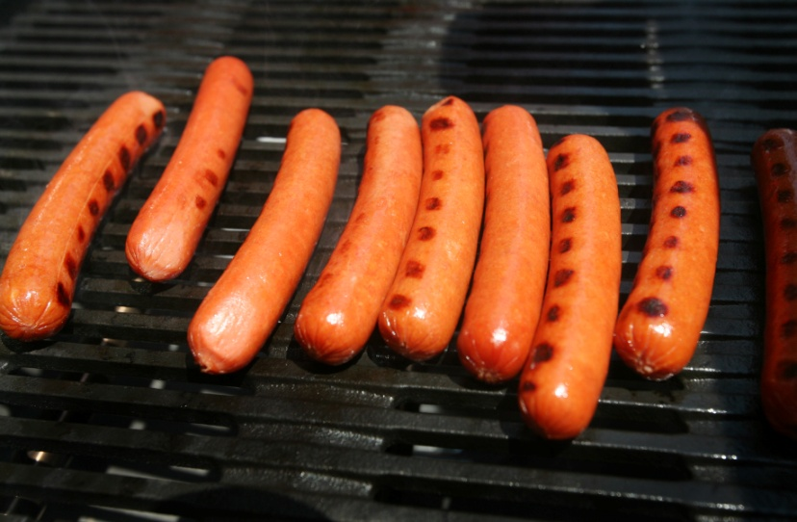
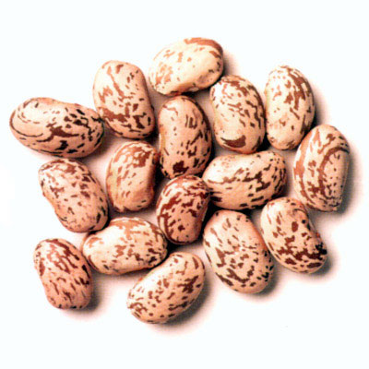
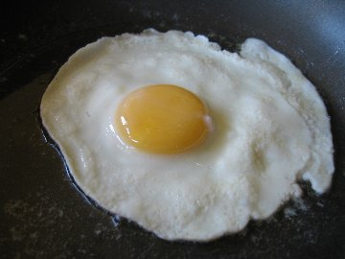
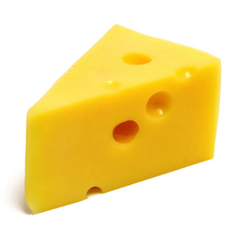
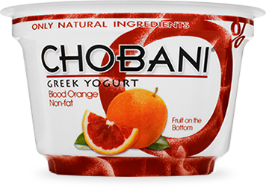
Examples of Protein
Notes:
When fish, or any protein, is being digested and broken down, what is it turned in to? Amino acid

Slide 4
Lipids
Lipids are edible fats and oils.
Lipids are broken down into fatty acids.
Lipids cannot be produced in the body; it is
important to eat a balanced diet containing
lipids.
A lack of lipids in the body can result in
many nutrient deficiencies.

Slide 5
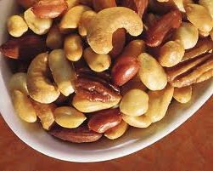
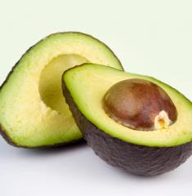
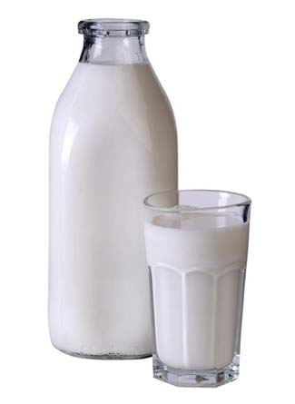
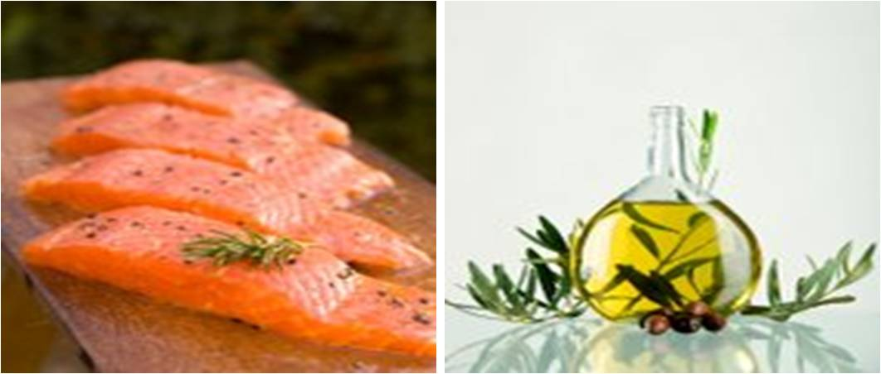
Examples of Lipids in Your Diet
Notes:
How are the lipids that are found in milk broken down in your body during digestion? They are broken down into fatty acids.

Slide 6
Carbohydrates
Carbohydrates are the primary fuel
source for your working muscles and
brain.
Carbohydrates are broken down into
simple sugars and starches

Slide 7
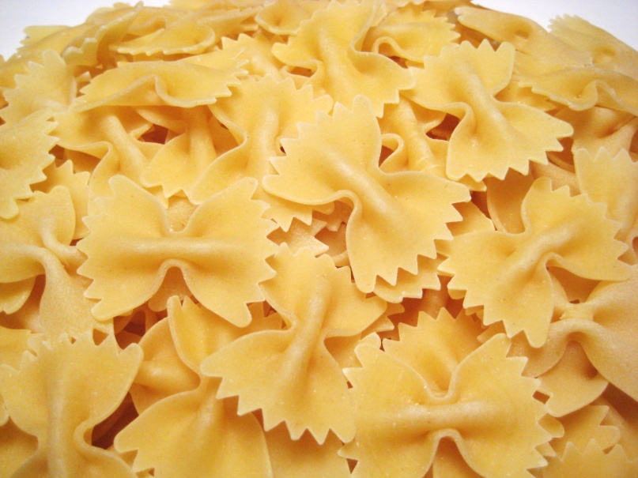
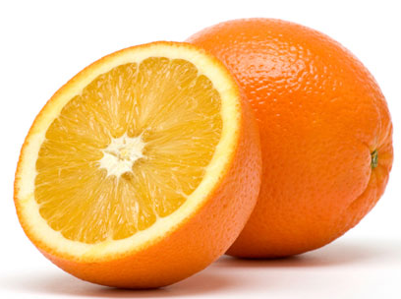
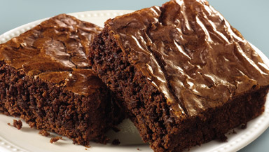
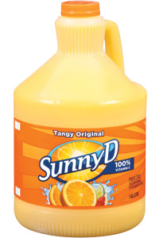
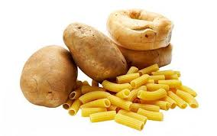
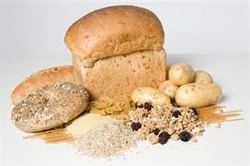
Examples of Carbohydrates
Notes:
What does pasta become as it is broken down in your body during digestion? Simple sugars

Slide 8
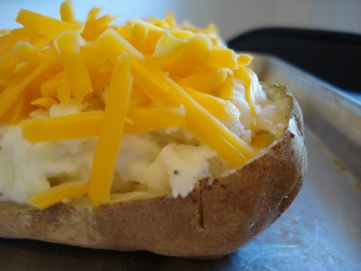
How will this baked potato be broken down once digestion is complete?
Notes:
Students should ask to see the nutritional label for a baked potato to understand the composition of the baked potato.

Slide 9
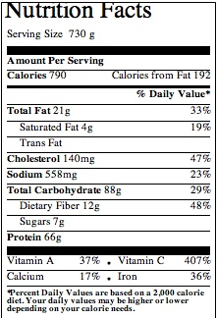
Nutritional label for a baked potato
Notes:
Does this baked potato contain more lipids, carbohydrates, or proteins? Carbohydrates
Which large molecule will yield simple sugars? Carbohydrates
Which large molecule will yield amino acids? Proteins
Which large molecule will yield fatty acids? (Fats) Lipids

Slide 10
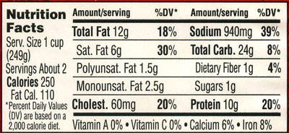
Notes:
Does this 20oz bottle of coca cola contain more lipids, carbohydrates, or proteins? Carbohydrates
Which large molecule will yield simple sugars? Carbohydrates
Which large molecule will yield amino acids? Proteins
Which large molecule will yield fatty acids? (Fats) Lipids

Slide 11
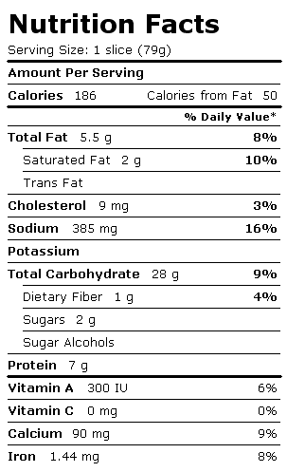
Nutritional label for a 12” hand tossed cheese pizza.
Notes:
Does this pizza slice contain more lipids, carbohydrates, or proteins? Carbohydrates
Which large molecule will yield simple sugars? Carbohydrates
Which large molecule will yield amino acids? Proteins
Which large molecule will yield fatty acids? (Fats) Lipids

