Slide 1
7th Grade Heredity Unit

Slide 2
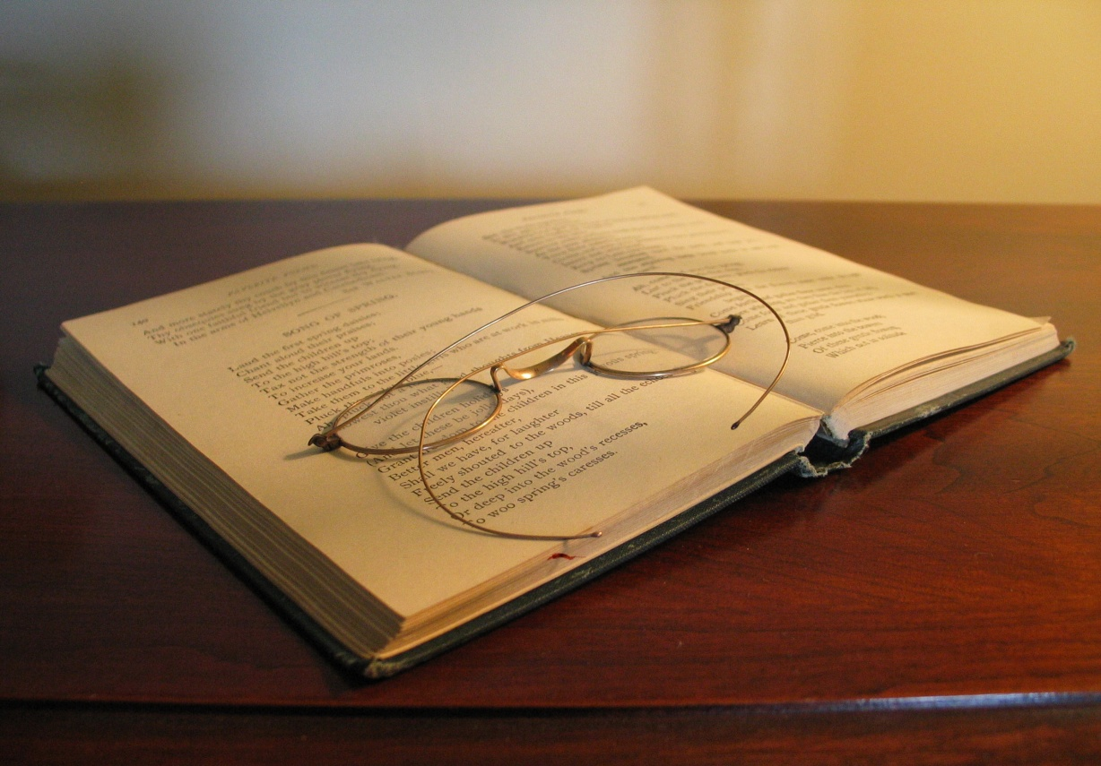
Genetics
The study of heredity.
Image from: http://www.racc.edu/faculty/mkelly/PSCS2/Unit3Basic_TurnUpHeat/Open%20book.jpg; Definition: www.thefreedictionary.com.

Slide 3
Heredity
The passing of traits from one generation to another.
Image adapted from: http://content.tutorvista.com/science/CBSEXScience/Ch529/images/img1.jpeg; Definition adapted from: ScienceSaurus glossary, page 491

Slide 4
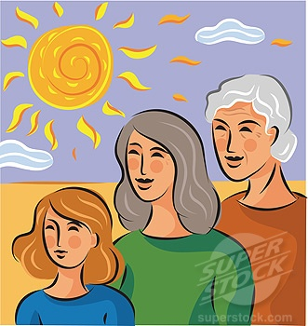
Generation
A group of people living during the same time and at the same stage of descent from an ancestor.
This image contains 3 generations of the same family.
Definition adapted from: Access Science glossary, page 316.

Slide 5
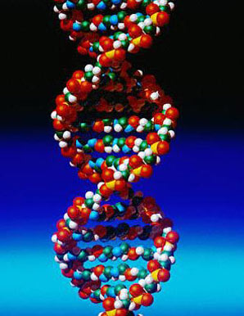
DNA
The material found in a cell’s nucleus that is responsible for the genetic traits of an organism.
Image from: http://3.bp.blogspot.com/_ZkSSURCm3FI/TQ3jNCZ4t2I/AAAAAAAALTw/ZqzqK42okU0/s400/01-coll-dna-knoll-l.jpg; Definition adapted from: ScienceSaurus glossary, page 482.

Slide 6
Inherited
Traits received by one’s parents.
Image adapted from: http://evolution.berkeley.edu/evolibrary/images/family_tree.gif; Definition: www.thefreedictionary.com.

Slide 7
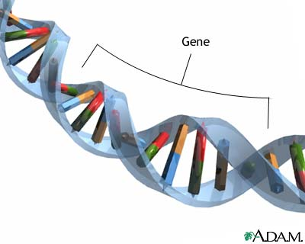
Genes
A segment of DNA that determines the inheritance of a trait.
Image from: http://static.howstuffworks.com/gif/adam/images/en/9344-genes-picture.jpg; Definition adapted from: ScienceSaurus glossary, page 488.

Slide 8
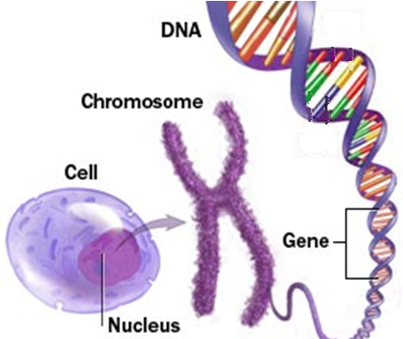
Chromosomes
The structure in the cell’s nucleus that contains instructions for the cell and the entire organism.
Image adapted from: http://www.riversideonline.com/source/images/slideshow/r22_chromosome.jpg; Definition adapted from: Access Science glossary, page 312.

Slide 9
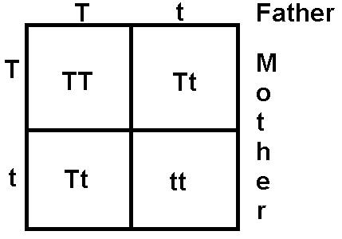
Allele
Allele
One of a pair of genes that determines a specific trait.
Image from: http://www.bio200.buffalo.edu/labs/images/Monohybrid.jpg; Definition from: ScienceSaurus glossary, page 468.

Slide 10
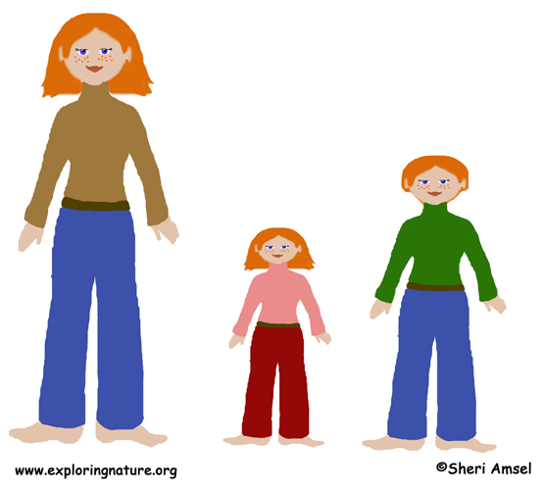
Trait
A feature that can be controlled by genes, such as eye color, hair color, and height.
Image adapted from: http://www.exploringnature.org/graphics/teaching_aids/2.1a_traits_inherited72.jpg; Definition from: Access Science glossary, page 323.

Slide 11
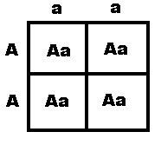
Dominant Allele
The allele that is “stronger”. The offspring will have the trait represented by the dominant allele.
The dominant allele
represented by the “A”.
Image from: http://www.muskingum.edu/~psych/psycweb/history/mendelchart.gif; Definition adapted from: Access Science glossary, page 314.

Slide 12
Recessive Allele
The allele that is “weaker”. The offspring will not have the trait represented by the recessive allele.
The recessive allele represented
by the “a”.
Image from: http://www.muskingum.edu/~psych/psycweb/history/mendelchart.gif; Definition adapted from: Access Science glossary, page 314.

Slide 13
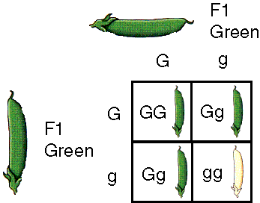
Genotype
The set of genes carried by an organism.
The genotype of the peas are GG,
Gg, and gg.
Image from: http://www.proprofs.com/flashcards/upload/a3280580.gif; Definition from: ScienceSaurus Glossary, page 488.

Slide 14
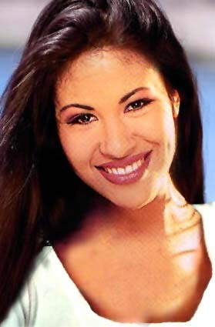
Phenotype
The physical appearance
of an organism.
The trait that is expressed. Expressed means to have, to see, or to exhibit.
The phenotypes for Selena are brown hair and brown eyes.
Image from: http://www.glogster.com/media/1/6/36/63/6366380.jpg; Definition from: ScienceSaurus glossary, page 506.

Slide 15
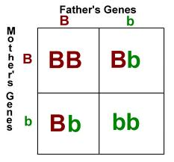
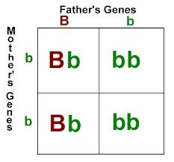
Punnett Square
A tool used by scientists to show the possible genotypic outcomes from known parents.
Shows possible allele combinations.
Image adapted from: http://feistyhome.phpwebhosting.com/punnett4.gif;

Slide 16
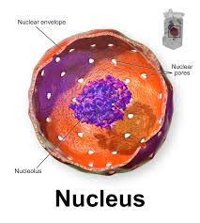
Nucleus
The organelle that contains the genetic material of a cell. Found in plant and animal eykoratic cells.
The recessive allele represented
by the “a”.
Image from: http://www.muskingum.edu/~psych/psycweb/history/mendelchart.gif; Definition adapted from: Access Science glossary, page 314.

Slide 17
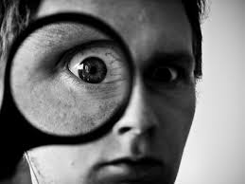
Express
To see or to show. The offspring expressed the trait of a long tail.

Slide 18
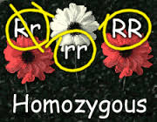
Homozygous
When both alleles inherited are the same; TT or tt
Often referred to as purebred!
Image from: http://t1.gstatic.com/images?q=tbn:ANd9GcQCSHW2yWeE-b66xbf3XZ7rZgnhr-XCKb-eNOmMGsfWpQhzA88oLg:rmascience.weebly.com/uploads/9/2/2/3/9223506/6102278_orig.gif

Slide 19
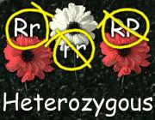
Heterozygous
When the alleles inherited are different; Tt
Often referred to as hybrid!
Image adapted from: http://t1.gstatic.com/images?q=tbn:ANd9GcQCSHW2yWeE-b66xbf3XZ7rZgnhr-XCKb-eNOmMGsfWpQhzA88oLg:rmascience.weebly.com/uploads/9/2/2/3/9223506/6102278_orig.gif; Definition adapted from:

Slide 20
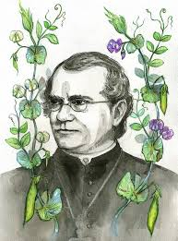
Gregor Mendel
Artisan Monk that is considered the father of modern genetics. Studied pea plants to discover how traits are passed.
Imag

