Slide 1
Cycling of Biomass and Composting
You will demonstrate and explain the cycling of matter within living systems such as in the decay of biomass in a compost bin
TEK 7.5b

Slide 2
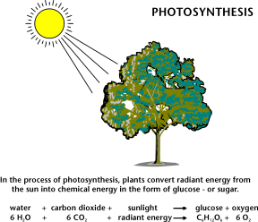
What is Biomass?
Biomass
is organic material made from plants and animals. (Organic means it contains the element carbon and is made from plant or animal products)
contains stored energy from the sun.
Plants absorb the sun's radiant energy
in a process called photosynthesis.
The chemical energy in plants gets passed on to animals and people that eat them.
Notes:
Check Card Sort after this slide

Slide 3
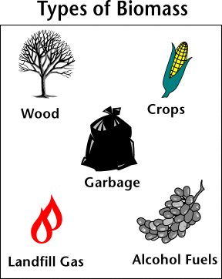
Biomass
Renewable Energy Source
WHY?
We can always grow more and when organisms die, they decay and release energy

Slide 4
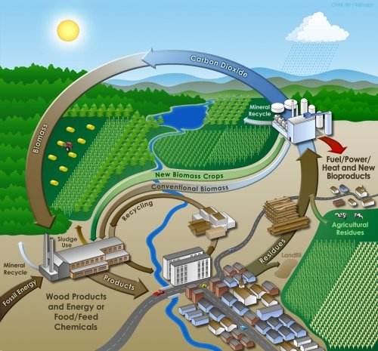
The Carbon Cycle

Slide 5
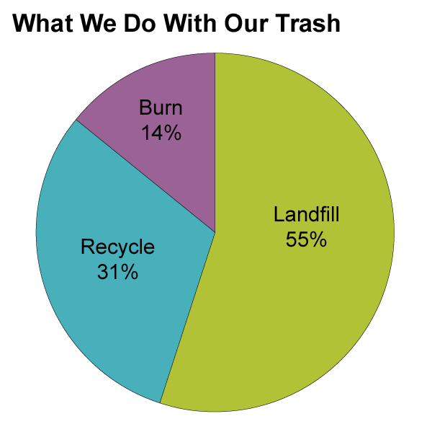
How do we contribute to the cycle?

Slide 6
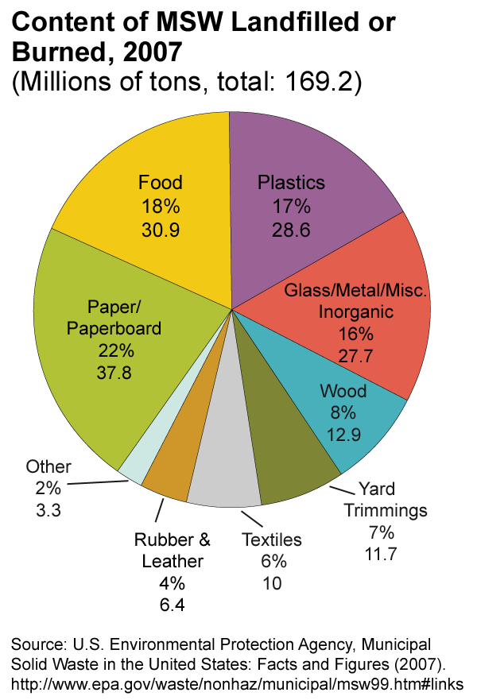
What percent of waste put in landfills or is burned is considered biomass?
Food 18%
Paper Products 22%
Wood 8%
Yard Trimmings 7%
Textiles 6%
61%

Slide 7
Composting
In 1960 the average American threw away 2.7 pounds of trash a day.
Today each person throws away about 4.5 pounds a day. (That comes to about 2000 lbs or 1 ton of trash/year!)
Composting can reduce our waste to landfills.
Composting is a way to recycle organic solid waste.
Composting Video Clip

Slide 8
Lab: Compost Bin/Container
Composting Hints
Meat and dairy products are high in fat and will cause an unpleasant odor if added to a poorly-managed compost pile. Running them through a blender will speed up their decomposition.
Worms can reduce composting time by 50%.

Slide 9
Composting Game
Informational Site:
http://www.eia.doe.gov/kids/energy.cfm?page=biomass_home-basics-k.cfm
http://home.howstuffworks.com/composting.htm/printable
http://public.doe.k12.ga.us/DWPreview.aspx?WID=89&obj=54282&mode=1

