Slide 1
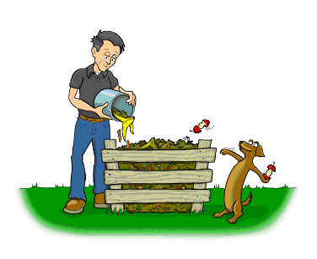
Composting and Matter Cycling
SE 7.5B A student is expected to demonstrate and explain the cycling of matter within living systems such as in the decay of biomass in a compost bin;

Slide 2
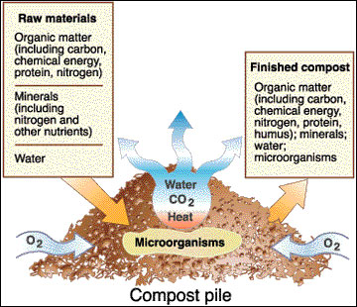
What is a compost pile?
A controlled space where humans decompose organic matter to turn it into a useful resource that helps to replenish organic matter back into the earth.

Slide 3
How does composting work?
Organic matter (rich in carbon and nitrogen such as scrap food ) are put into a container.
Decomposers (fungus and bacteria) break down the organic matter.
Decomposers require water and air.
The organic matter becomes compost, a soil-like, humus-like material that is used to

Slide 4
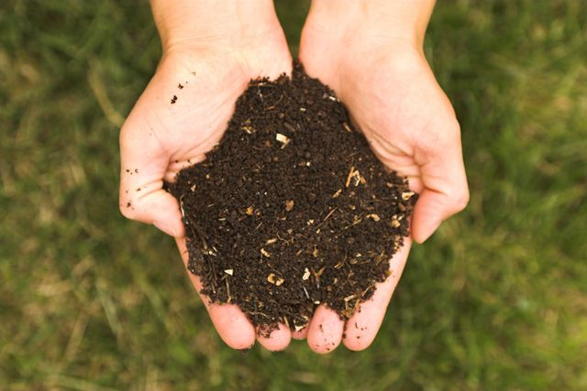
Compost

Slide 5
Where would “composting” naturally take place?
Anywhere there is organic matter that dies, bacteria and fungus cause the matter to decay.
The carbon and nitrogen in the organic matter are returned back into the matter cycles.
Example: forest floor where leaves fall down and decay

Slide 6
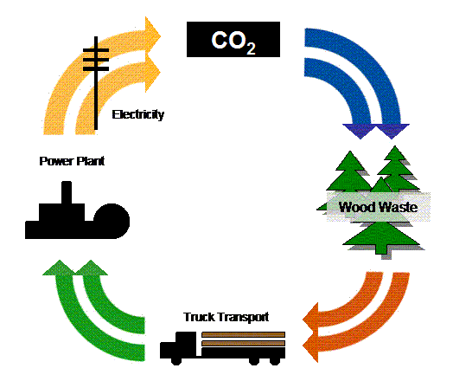
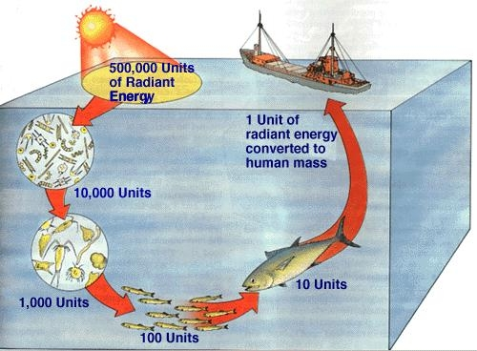
Biomass
The total mass of the organic matter at each trophic level is called biomass
Biomass is just another term for potential energy – energy that is to be eaten and used
The transfer of energy from one level to another is very inefficient

