Slide 1
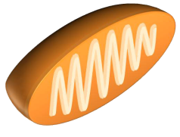
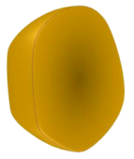
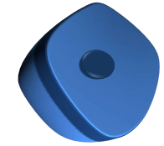
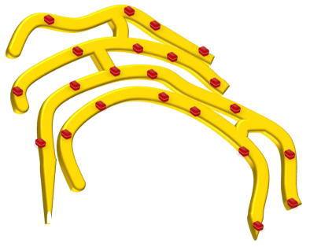
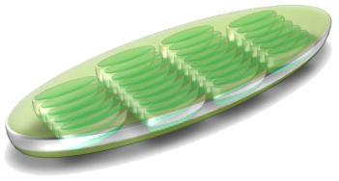
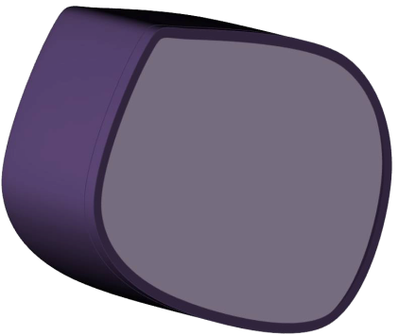
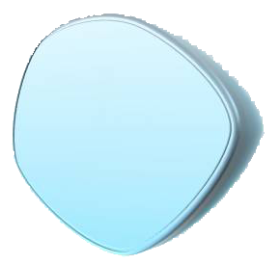
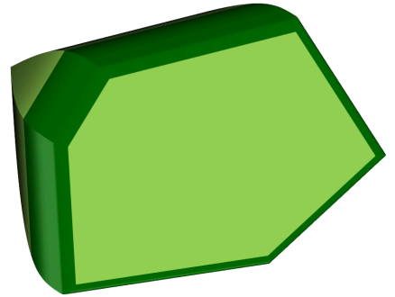
Animal Vs. Plant Cell & Organelles
7.12D Differentiate between structure and function in plant and animal cell organelles, including cell membrane, cell wall, nucleus, cytoplasm, mitochondrion, chloroplast, and vacuole

Slide 2
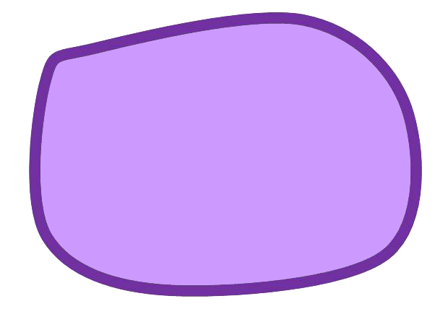
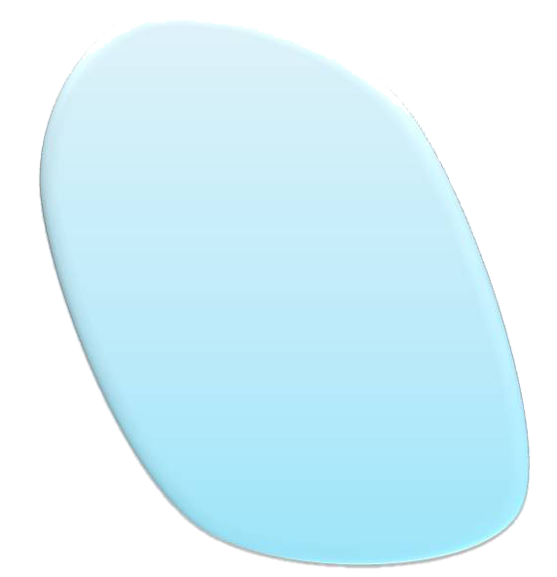
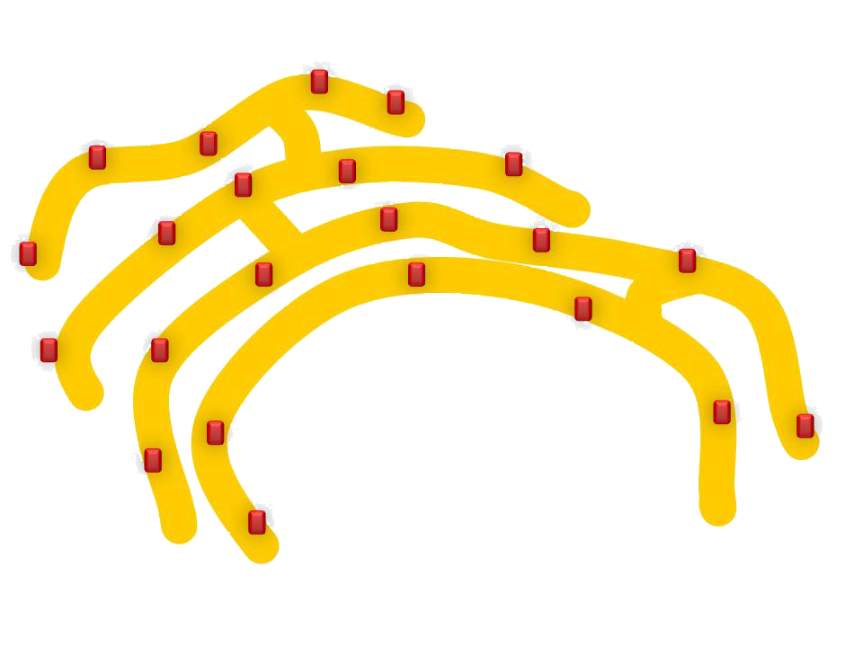
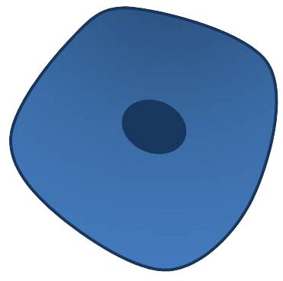
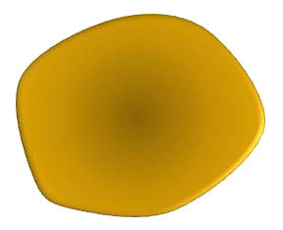
ANIMAL CELL
Mitochondria
Vacuole
Cell Membrane
Golgi body
Cytoplasm
Nucleus
Ribosomes
Lysosome
Endoplasmic Reticulum

Slide 3
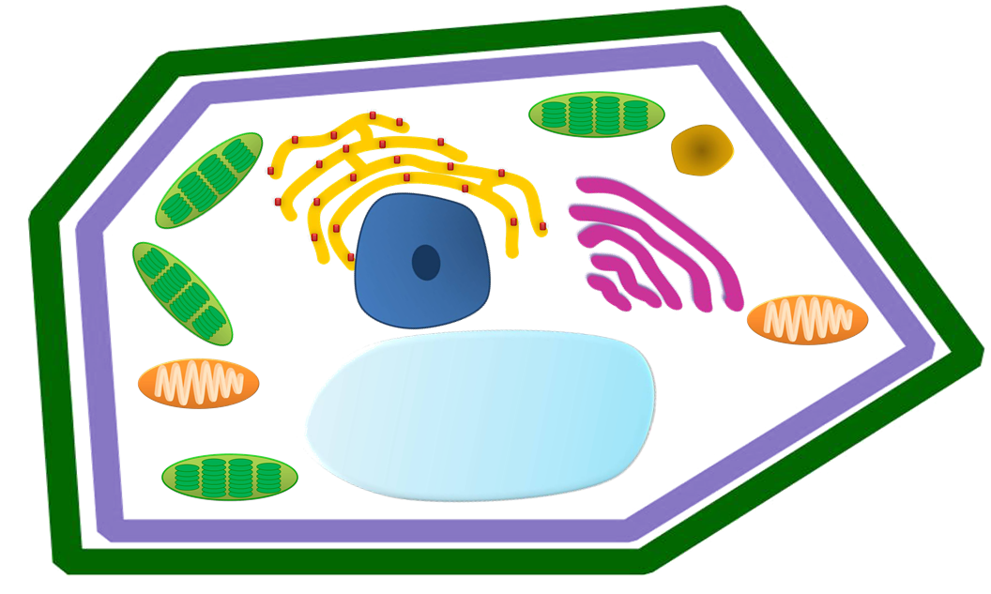
PLANT CELL
Lysosome
Endoplasmic Reticulum
Chloroplast
Mitochondria
Golgi body
Ribosomes
Cytoplasm
Nucleus
Cell Wall
Cell Membrane
Vacuole

Slide 4
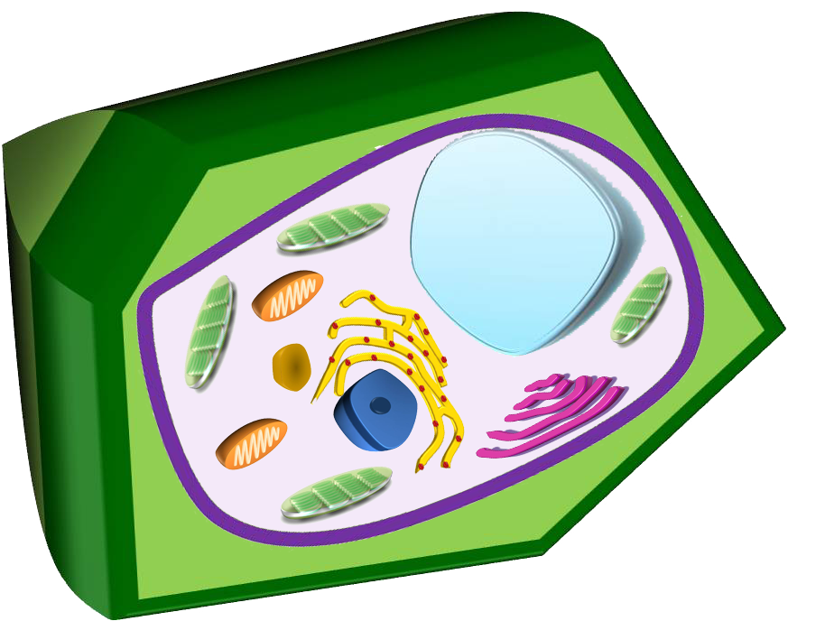
So Which is Which and Why?
In your science journal write a few sentences about how you can identify different organelles and the two types of cells.

