Slide 1
Adaptations
Objective: Students will investigate and explain how INTERNAL structures of organisms have adaptations that allow specific functions.

Slide 2
What is an adaptation?
An inherited trait that helps an organism survive

Slide 3
In your journal…
List as many adaptations in living organisms that you can think of.

Slide 4
In your journal…
Circle the adaptations that are INTERNAL or occur within the organism.

Slide 5
3 Need-to-Know Examples of Internal Adaptations
Gills in Fish
Xylem in Plants
Hollow bones in Birds

Slide 6
Gills in Fish
Internal Structure:
Gills
Function:
Gills are the respiratory organs of fish.
First, a fish swallows water through its mouth. Then the water flows over the gills.
The gills take out oxygen from the water which passes back out of the fish.
The oxygen is then absorbed through the capillaries into the blood stream of the fish.

Slide 7
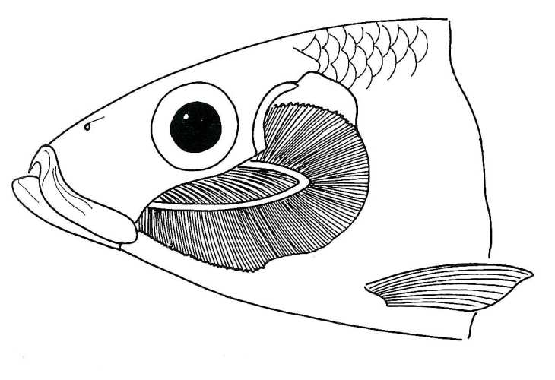
Gills in Fish

Slide 8
Xylem In Plants
Internal Structure:
Xylem
Function:
Part of a plant's vascular system that transports water and minerals from the roots to the rest of the plant
and furnishes support.
The xylem makes up the major part of a stem or root and the wood of a tree.
The xylem consists of special water-conducting
tissues made up mostly of several types of narrow,
long, hollow cells.

Slide 9
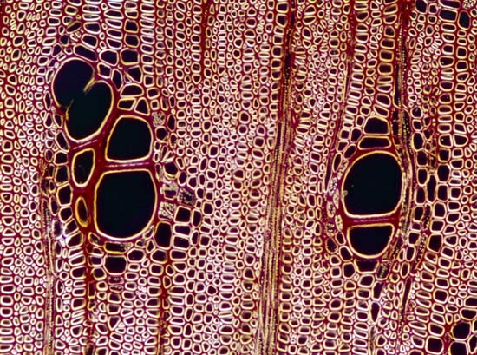
Xylem In Plants
Cross section of oak xylem

Slide 10
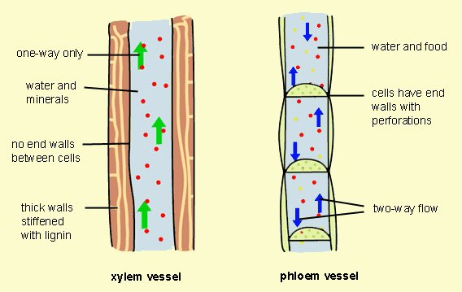
Xylem In Plants

Slide 11
Hollow Bones in Birds
Internal Structure:
Hollow Bones
Function:
Hollow bones is just one of the advantages birds have gained through evolution. This makes them light, and a light body allows them to fly faster, using less energy.
It takes a lot of energy to fly. The more a bird weighs,
the more energy it takes to fly.
Eagles, for example, have a lightweight frame that gives them maximum strength with the least possible amount of weight.
In fact, the weight of an eagle's skeleton is only half a pound.

Slide 12
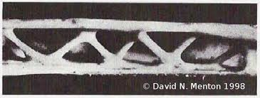
Hollow Bones in Birds

Slide 13
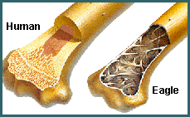
Hollow Bones in Birds

Slide 14
Internal Adaptations of an Archer Fish

Slide 15
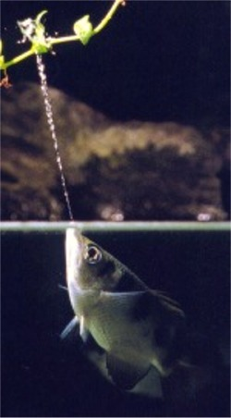
In the quiet waters of the Orient, there is an unusual fish known as the Archer fish. It is unlike any other fish in that it finds its prey outside of the water.
The archer fish are known for their habit of preying on land-based insects and other small animals by literally shooting them down with water droplets from their specialized mouths.

Slide 16
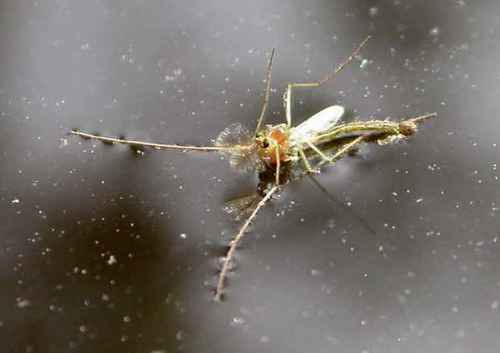
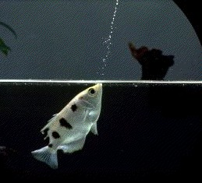
The insect falls into the water and the Archer fish consumes it.
Archerfish are remarkably accurate in their shooting. They can bring down an insect on a branch of an overhanging tree up to 6 feet above the water's surface.

Slide 17
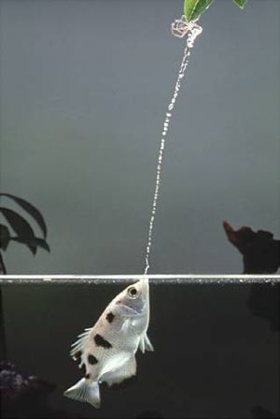
The fact that the Archer fish can do this time and again with pinpoint accuracy is even more remarkable.

Slide 18
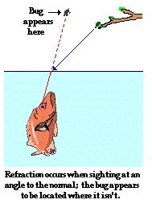
The archer fish accomplishes this trick despite the fact that light from the prey to its eye undergoes refraction (the bending of light) at the air-water boundary.
Such refraction causes the prey to appear to be in a location where it isn't.
Yet the Archer fish is hardly ever fooled.

Slide 19
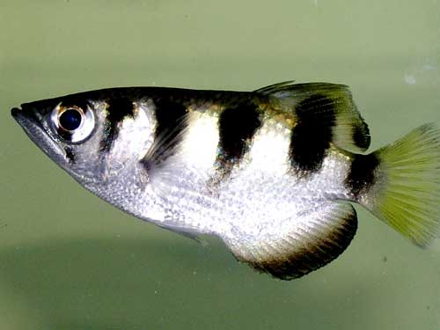
This is partially due to their good eyesight, but also their ability to compensate for the refraction ( the bending of light) of light as it passes through the air water interface when aiming for their prey. They typically spit at prey at a mean angle of about 74 degrees from the horizontal, but can still aim accurately when spitting at angles between 45 and 110 degrees.

Slide 20
Click on the picture below to watch a video of the amazing archer fish.

Slide 21
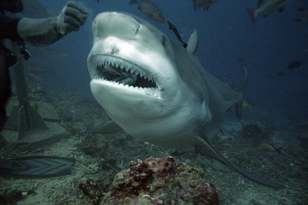
Freshwater & Saltwater Living
A bull shark has the ability to live in both freshwater and in saltwater. This is due to osmoregulation.
A bull shark in Potomac River. The Potomac River is adjacent to Washington DC

Slide 22
Osmoregulation is the ability of an organism to maintain a constant concentration of water in its body even when its outside environment would normally cause it to lose or gain water. Freshwater and saltwater fish both osmoregulate.

Slide 23
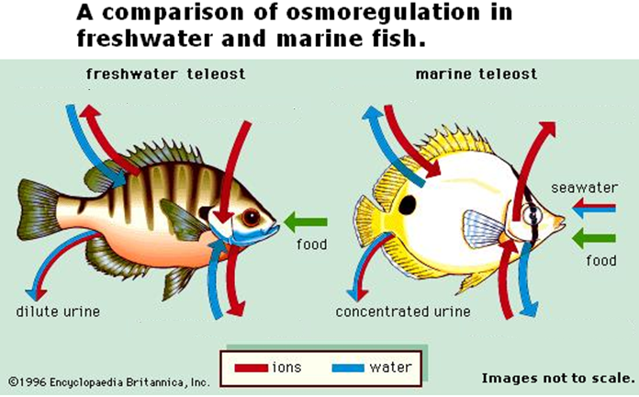
Bull sharks can adapt their osmoregulatory processes to survive in the salt water of the ocean to the fresh water of a lake. Other sharks and fish cannot adapt their osmoregulatory process.

Slide 24
In your science notebook, explain how specially adapted internal structures allow organisms to survive.

